Slide 1

Toronto Police Department – Final Presentation
Toronto Police Department
Most important crime indicators
Namrakumar Patel (200535046)
Gaurav Gaurav (200578193)
Samarjeet Singh (200558169)
Big Data Analytics – BDAT1011

Slide 2

Project Summary
Toronto Police Data Portal is an invaluable resource that provides a comprehensive and enriched perspective on data from different time periods.
Data offers detailed insights into a wide range of criminal activities, presenting a vast array of statistical information.
Main objective is to provide the Toronto Police Department with a comprehensive report on key crime indicators.
Analysis will provide essential insights into the complex dynamics of criminal activities over time.
Main goal is to provide more security for such occasions when criminal record is high.
It is an independent study, will be done by us.

Slide 3
Team Profile
Project Manager (Namrakumar Patel)
Data Analyst ( Samarjeet Singh)
Developer ( Gaurav Gaurav)
Bachelor’s of Science
Bachelor’s of Communication and Engineering
Full Stack Developer ( 2 Year)
Bachelor of Computer Engineering
Post Gradution of Artificial Intelligence
Currently pursuing Big Data Analytics
Currently pursuing Big Data Analytics

Slide 4
Roles & Responsibilities
Project Manager
Data Analyst
Developer
Managing Team & Weekly status report
Assigning and status check of the task
Data Collection
Data Cleaning
Data Analysis
Develop optimal solution
Create visualization using PowerBI
Helping team and continuous evolution

Slide 5
Project Scope
This project aims to thoroughly investigate crime trends and patterns throughout the entire city of Toronto. To achieve this, we will gather data from the Toronto Police Department's Major Crime Indicators dataset and employ advanced statistical analysis techniques to uncover significant trends in criminal behavior over time. Our study will meticulously examine crime rates across different offense categories and in various areas, with the goal of gaining deeper insights into the nature of crime. Additionally, we will explore potential seasonal fluctuations in crime and identify any socioeconomic or demographic factors that may be linked to crime rates.
By conducting this comprehensive analysis, our objective is to provide valuable insights into the complex nature of crime in Toronto. This research will serve to educate law enforcement agencies on effective strategies for deterring and combating criminal activity, thereby contributing to the creation of a safer and more secure community for all residents.

Slide 6
Project Management Statement
Project Goal
The goal of this project is to analyze the Toronto Police Department's major crime indicators data and identify patterns and trends in crime rates, types of crime, and geographical distribution. The analysis will aim to provide insights into the effectiveness of current policing strategies and inform potential changes to improve public safety in Toronto.
Project Deliverables
A comprehensive report and an in-person slideshow presentation of the approach taken for the project, the observations, and conclusions.
The analysis will involve an in-depth examination of various crime indicators, including but not limited to, homicide, assault, sexual assault, robbery, break and enter, theft, and motor vehicle theft. The results of the analysis will be presented in a clear, concise, and comprehensive manner, highlighting the key findings and insights obtained.
Knowledge transfer of all research, analysis, visualizations, analysis models, testing, codes, formulas, algorithms, technology, documentation, and work products.

Slide 7
Project Management Statement
Project Exclusion
Minor Crimes: The project primarily concentrates on Major Crime Indicators like homicide, robbery, sexual assault, and serious assaults. It's worth mentioning that minor offenses such as traffic violations, vandalism, and petty theft are not within the project's main focus.
Analysis of Police Responses: The analysis of crime data in the project aims to identify patterns or trends in criminal activity. However, it is beyond the project's scope to examine the police response to crime or evaluate the effectiveness of policing strategies.
Crime Prevention Strategies: Although it is important to understand the root causes of crime and explore possible solutions, the project does not involve developing or evaluating specific crime prevention strategies.
Limitation
Reason for not being able to find out a particular reason behind a crime: This question itself requires research on different aspects of the world such as war, weather, recession, etc. These all are generalized points that may come from different resources, we cannot depend on or state a solution from one source. Also, we cannot rely on a particular city's news, since factors causing crime may arise from any part of the world. It requires conclusions from different resources and requires investigation on which we are not currently focusing.
Dependency of data: We can only predict the upcoming incident (Crime) and assign force accordingly for Toronto Police Department from the given data. Also, data is only limited to a particular time period.

Slide 8
Justification Process
Why is important this project/solution/analysis?
Safety is priority for every police department.
Our analysis will help Toronto Police Department to find out key aspects of crimes.
By analyzing visualization, it will become easy to focus where to navigate.
The trend of crimes over the years can also be achieved through report.
How can your company resolve the problem by using this tool/finding/report?
Power-BI tool will help us to create visualization, to transform data, and to load data in different forms.
More functionality than other visualization tools such as editing the visualization, adding online visualizations, etc.
Our team will use these functionality to create a report, and from which we can gather information from past data.
Analyzing data and trend will acknowledge a team where to focus on a particular event or a date, and they can prevent a crime.

Slide 9
Communication Plan
Name | Role | Send/Receive Email | Weekly Meetings | Decisions | Documentation
Roshan Sahu | Instructor | Yes | Optional Attendee | Progression of Project | Grading
Namrakumar Patel | Project Manager | Yes | Attend, Book, Minutes, Agenda | Project and Task Management | Project Management Presentation components
Samarjeet Singh | Data Analyst | Yes | Attend | Data Analysis | Data gathering, Data Documentation
Gaurav Gaurav | Developer | Yes | Attend | Developing Result | Coding, Developing solution
The chart above describes the general Communication Plan including Roles and Responsibilities for the duration of the project.
Our minutes of meeting are available under “Minutes of Meeting” section in SharePoint.

Slide 10
High-Level Timeline Chart (GANTT)
The GANTT chart above shows the high-level tasks and expected dates for this project

Slide 11
Plans Status Report

Slide 12
Budget
Current Cost of Project
The table above shows a high-level view of the current cost of the project to-date.

Slide 13
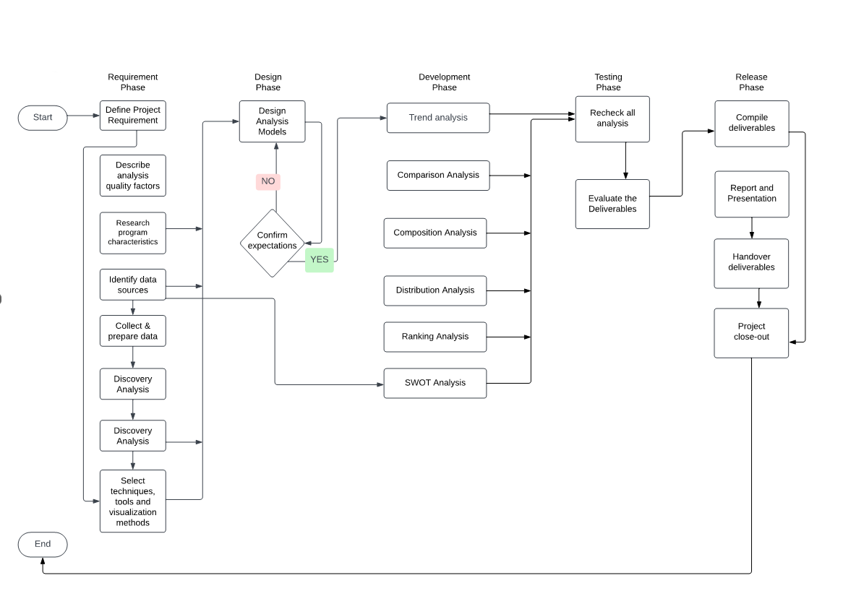
Flow Chart
The above flowchart will define our development process to achieve final result.

Slide 14

Glimpse of Work

Slide 15
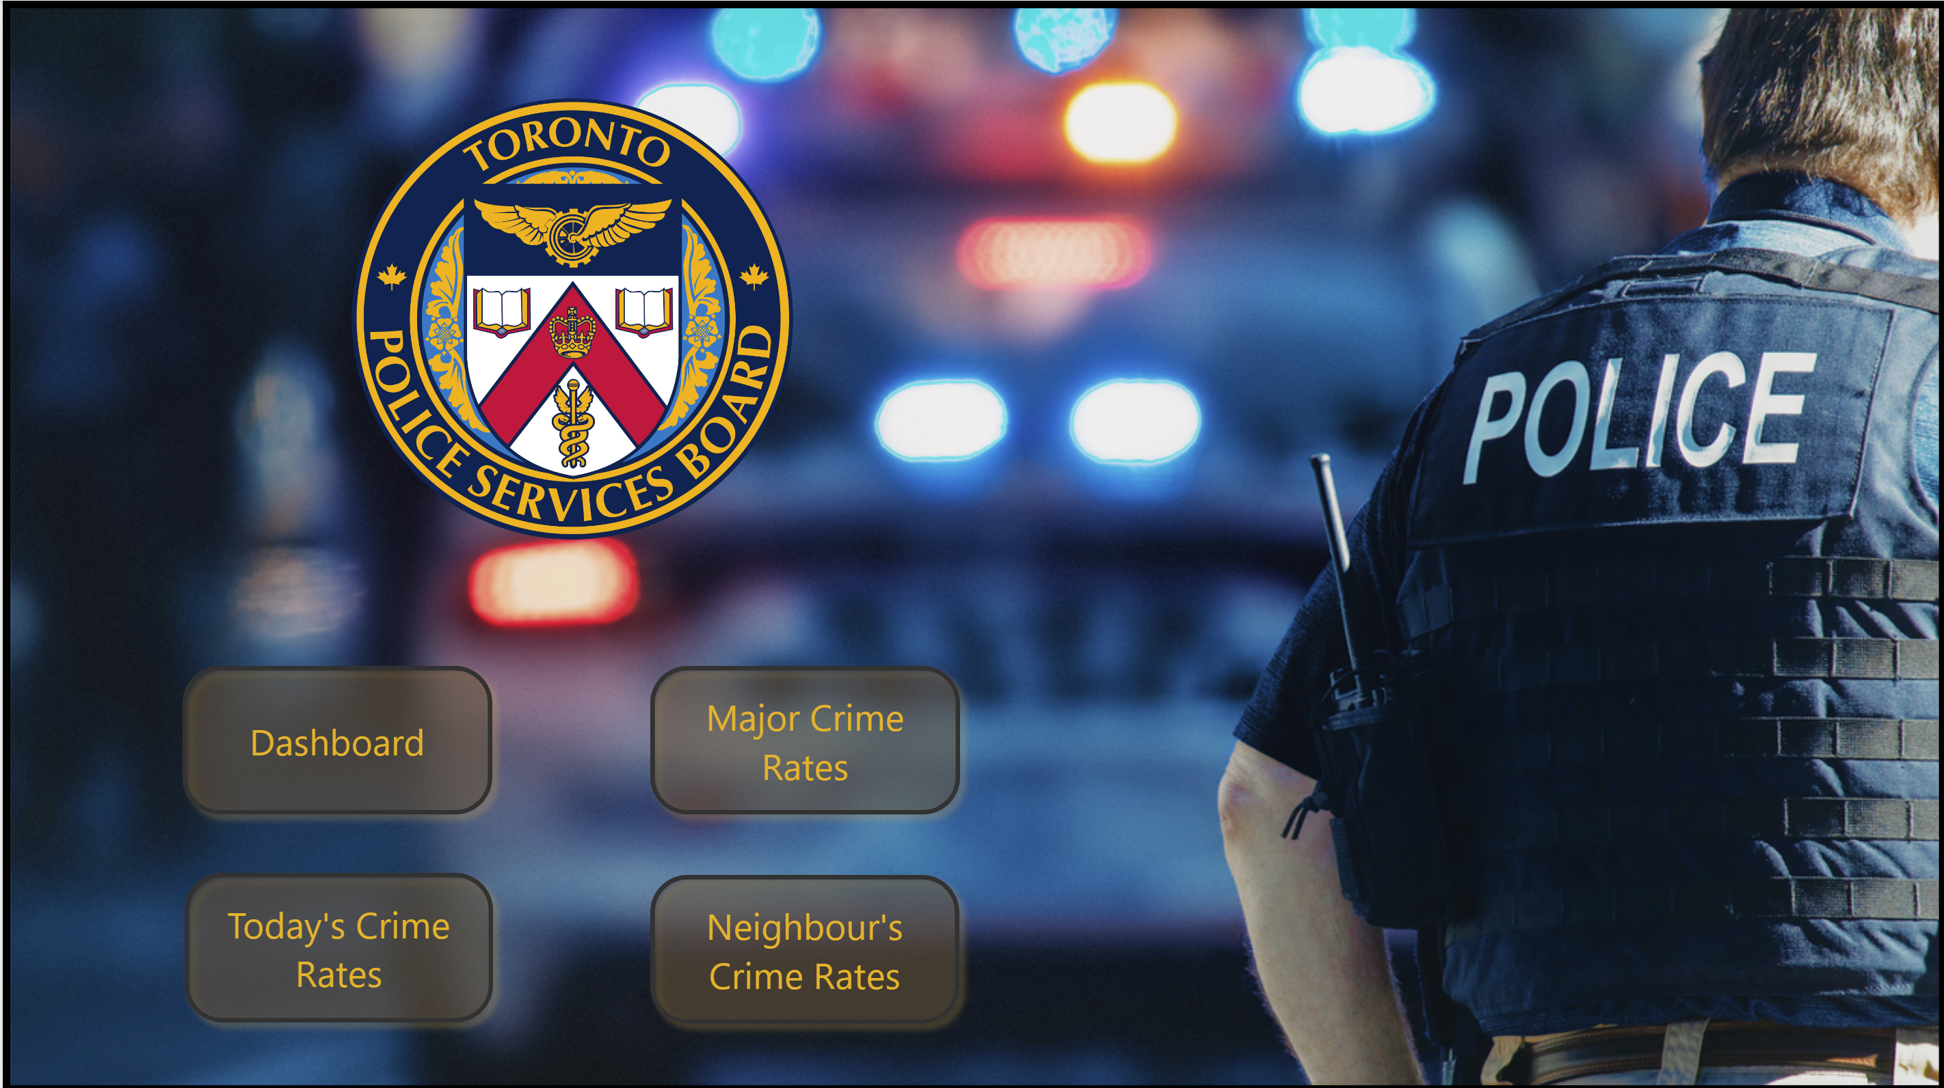
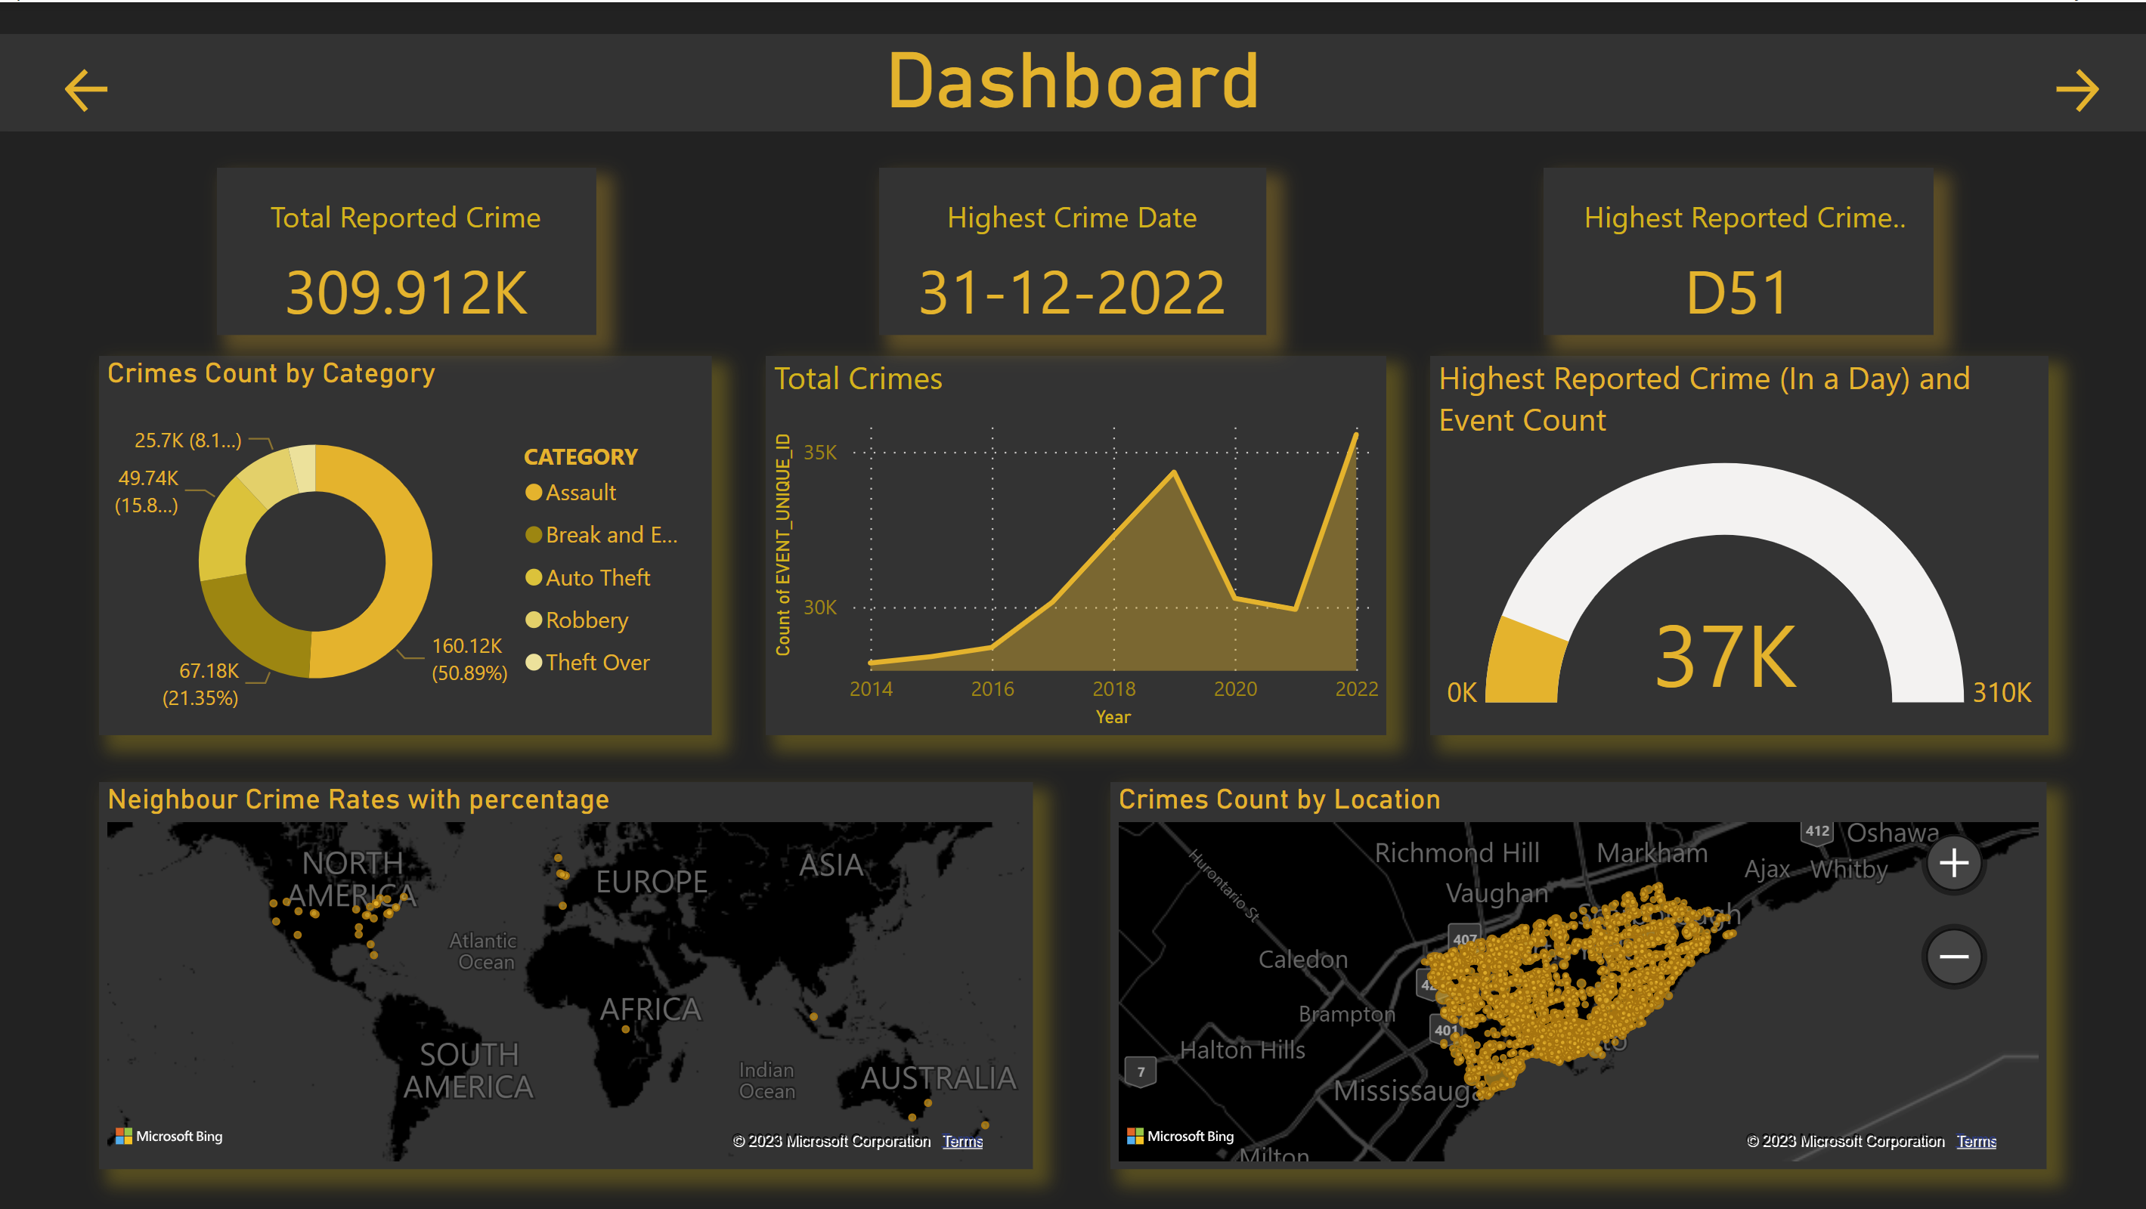
Home Page
Dashboard

Slide 16
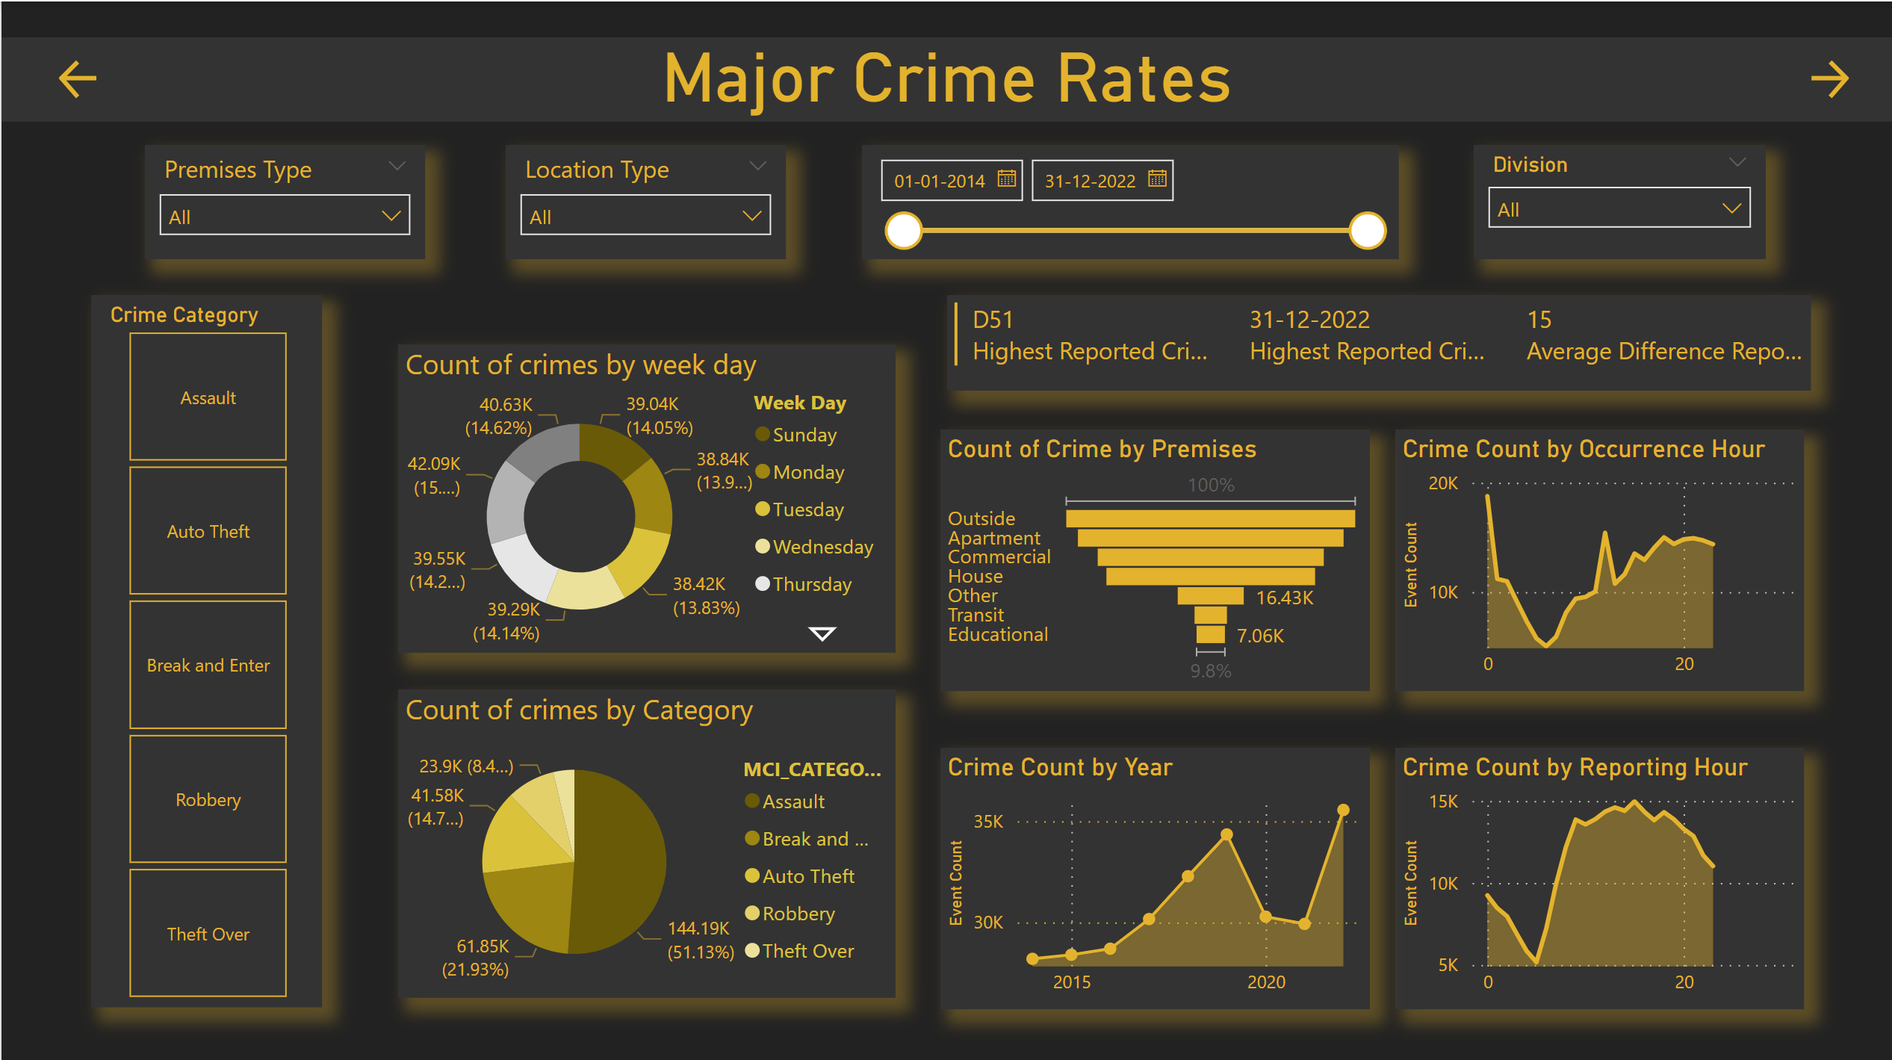
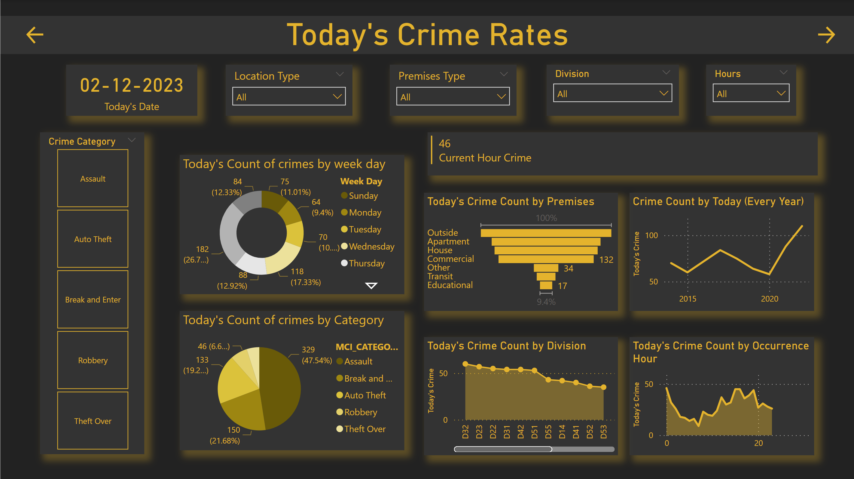
Major Crime Report
Today’s Crime Report

Slide 17
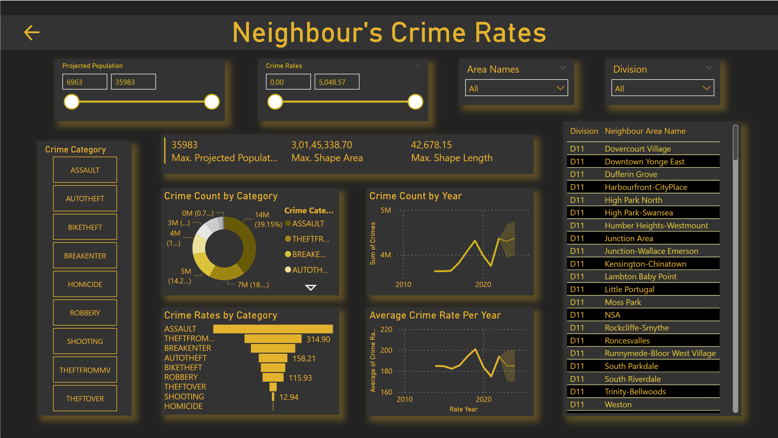
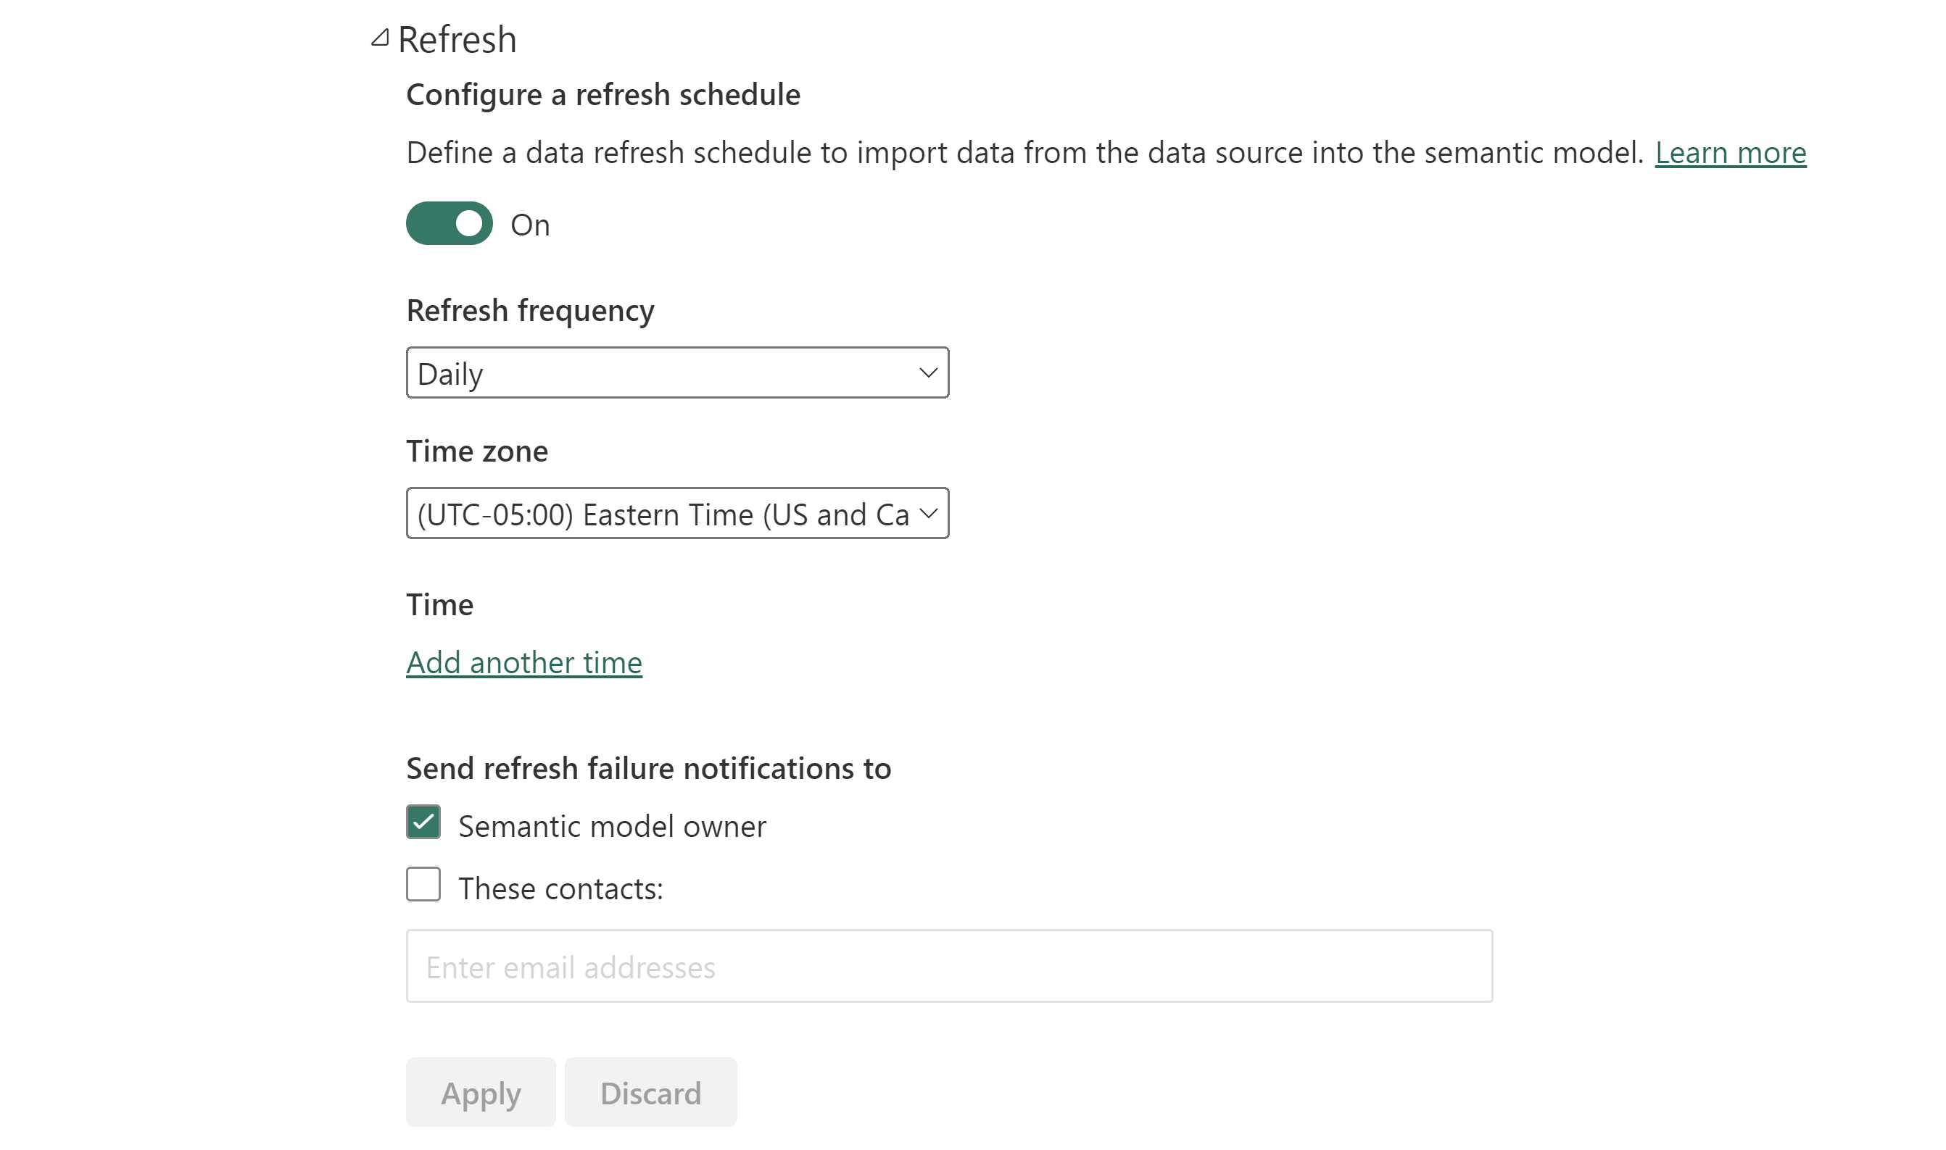
Neighbor’s Crime Report
Auto Refresh

Slide 18
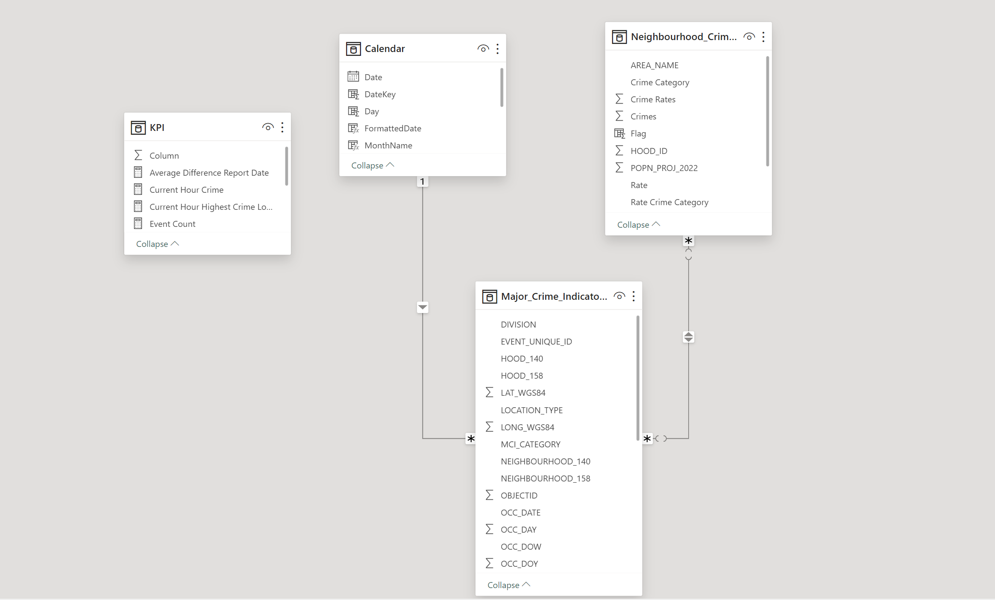
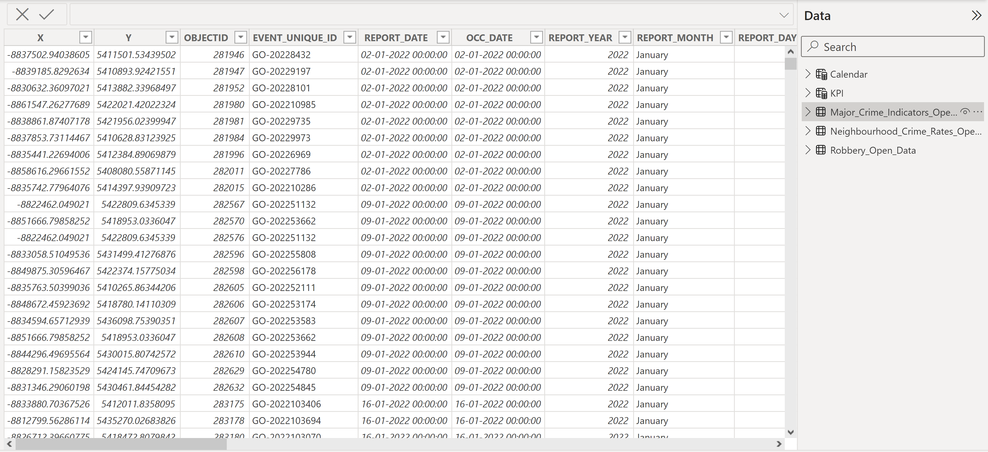
Relations between Tables
Load & Transformed Data

Slide 19
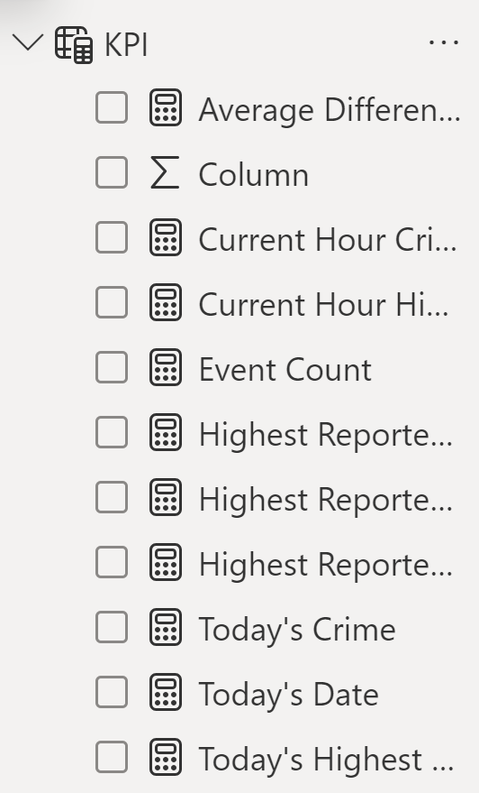
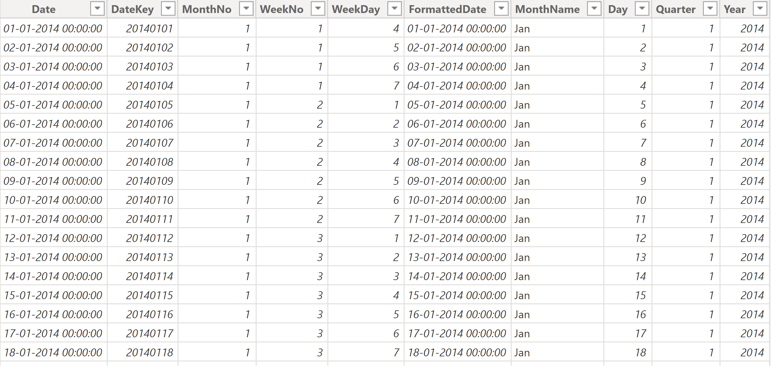
Calendar Table
KPI

Slide 20
References
Power Bi Report
https://app.powerbi.com/links/LEgwdDCN6x?ctid=da9a94b6-4681-49bc-bd7c-bab9eac0ad3c&pbi_source=linkShare
Share-point
https://georgiancollege.sharepoint.com/sites/TorontoPoliceDepartment
Toronto Police Department Data
https://data.torontopolice.on.ca/pages/open-data

Slide 21
Thank you

